Slide 1
Cross-Platform Multi-Process Brokered Applications
Karl Shifflett
Oceanware

Slide 2
Agenda
Problem Space
Building Blocks
Demo
Technologies
Shallow Dives
Takeaways

Slide 3
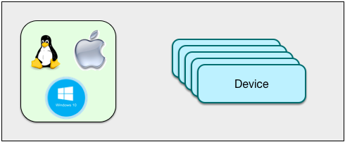
Problem Space
Statement: Remotely monitor and control N devices
Requirements
Servers Installable Cross-Platform (Windows, OS X, Linux)
Remote Control Cross-Platform (Windows, OS X, Linux, Mobile)
Scalable (future session)
Securable (future session)

Slide 4
Problem Space: Real World
Manufacturing
Production Printing
Facility Management
Home or Office Automation
IoT
…

Slide 5
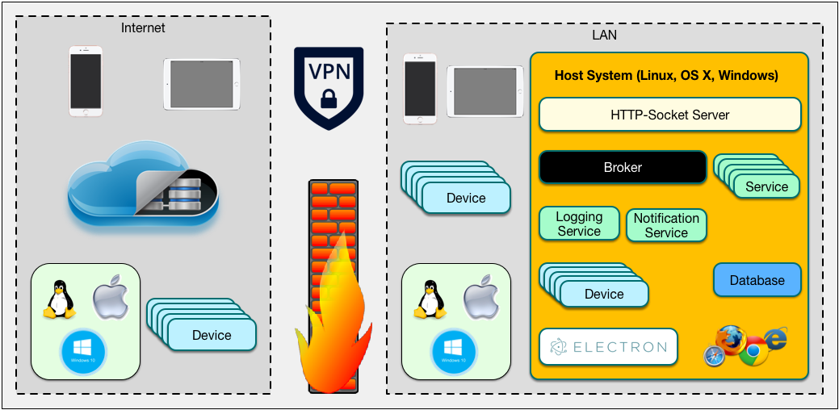
Building Blocks: Big Picture

Slide 6
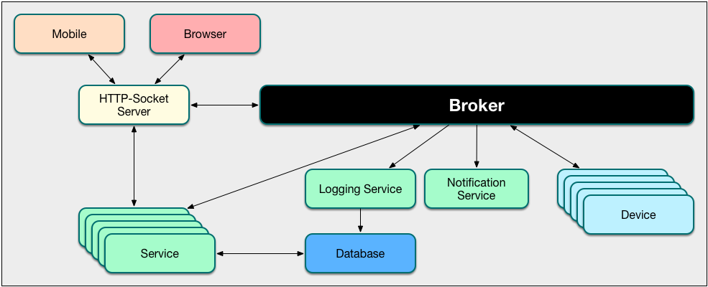
Building Blocks: Local System

Slide 7
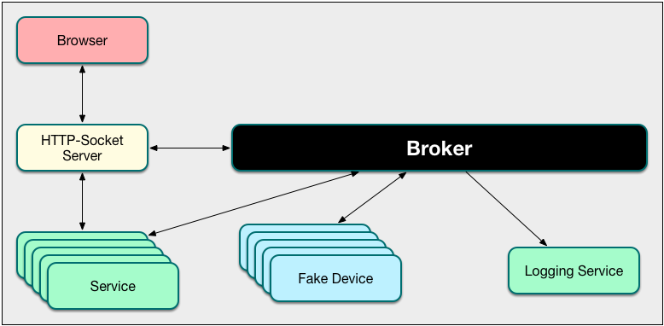
Building Blocks: CPBA Reference Implementation

Slide 8
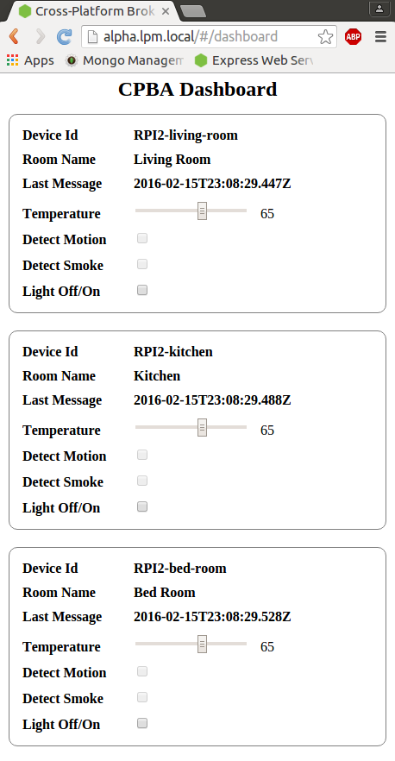
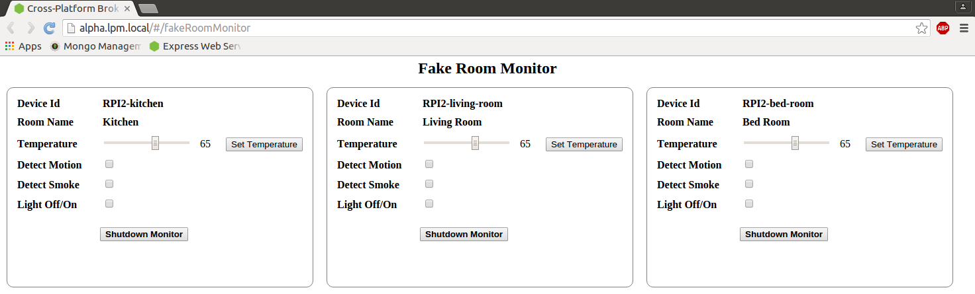
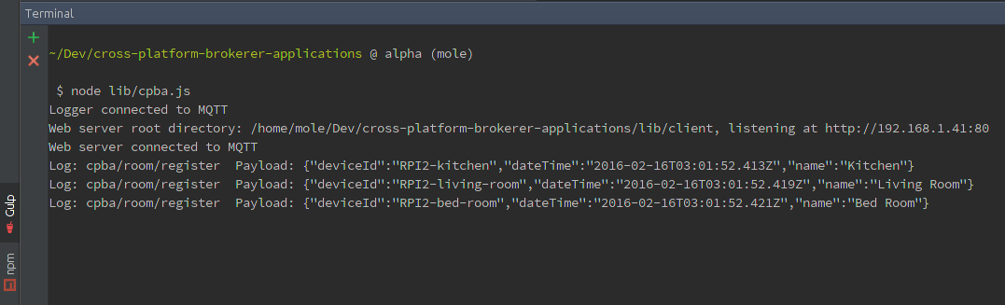
Demo: CPBA Client and Server Apps

Slide 9
Building Blocks Review and Questions

Slide 10


Technologies
Node.js® Runtime
TypeScript
HTML5, JavaScript, CSS3
AngularJS
MQTT
Mosquitto MQTT Broker
Express
socket.io

Slide 11
Node.js® Runtime
Cross-platform, JavaScript runtime built on Chrome’s V8 Engine
Event-driven, non-blocking
Fast and efficient
npm for package ecosystem
Code in src/server folder is the Node.js application

Slide 12
TypeScript
Superset of JavaScript
Compiles to plain JavaScript
Strong type checking
Classes, inheritance, interfaces, enums
Public and private members
Uses d.ts files to resolve types

Slide 13
HTML5, JavaScript ES5, CSS3
Widely supported
Use your web client developer skills for server apps and desktop Electron apps
HTML5 Symantec tags
CSS3 provides comprehensive layout and rendering

Slide 14
AngularJS 1.x
Single Page Application (SPA)
Supports all browsers
Dynamic view loading
Extends HTML vocabulary
Extensible
Readable HTML & JavaScript
Quick to develop

Slide 15
MQTT
Machine-to-machine, IoT, connectivity protocol
Lightweight publish/subscribe messaging transport
Local or remote connections, small footprint
Platform/device independent

Slide 16
Mosquitto
Lightweight MQTT Broker
Brokers mediate and enable decoupled communications
Route incoming messages to subscribers
Provide QOS
Provide secure communications
Runs as O/S service

Slide 17
Express
Node.js web framework
Fast
Unopinionated
Minimalist
Pluggable middleware
Robust

Slide 18
socket.io
JavaScript library for realtime web applications
Realtime bi-directional communication between web clients and server
Transparently handles connections

Slide 19
Technologies Review and Questions
Node.js® Runtime
TypeScript
HTML5, JavaScript, CSS3
AngularJS
MQTT
Mosquitto MQTT Broker
Express
socket.io

Slide 20
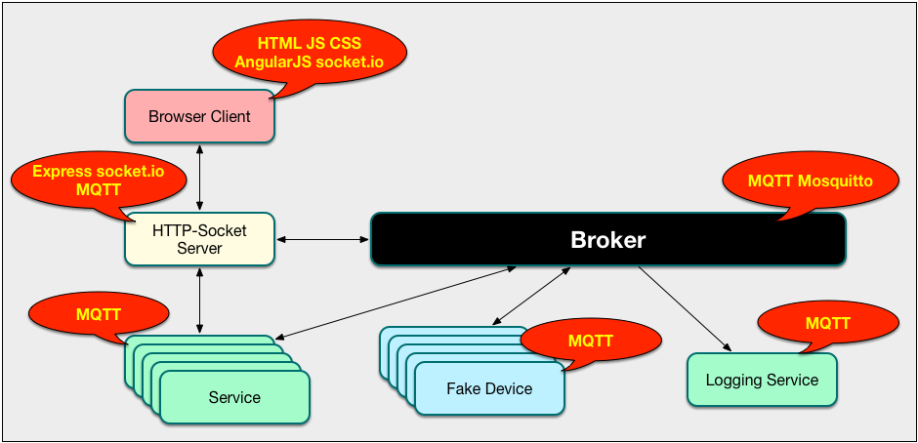
Building Blocks and Technologies Review

Slide 21
Application: Structure and Tools
WebStorm – cross-platform, smart JavaScript IDE
Client-side development, server-side Node.js development
Folder structure
src/client
src/server
lib/client
lib/server
gulp
tsc
tslint
How to run Node.js application

Slide 22
Shallow Dive: Node.js®
Runtime is cross-platform
npm is the package manager
package.json file
Easily create multi-process applications
Process management, creation, exiting
Piping process stdout, stderr
class, run() pattern

Slide 23
Shallow Dive: TypeScript
Enables authoring SOLID, readable, clean code
Base classes
Inheritance
Interfaces
Enums
tsc
Compiler and options
typings folder and contents
tslint

Slide 24
Shallow Dive: MQTT
Message Topic
Used by the Broker to filter messages
Topics have one or more levels
Case sensitive
Single level wildcard: +
Multi level wildcard: #
Message Payload
Connecting
Listening
Posting

Slide 25
Shallow Dive: Mosquitto
Broker
Installed to the O/S, runs as a service on start up
Includes command line publish and subscribe methods
QOS
0 – deliver once, no confirmation
1 - deliver at least once, with confirmation
2 – deliver exactly once, with confirmation
Last will and testament

Slide 26
Shallow Dive: Express
Middleware
Routes
Starting Express
Serving static content
Controllers

Slide 27
Shallow Dive: socket.io
Server
Piggy backs on Express application
Event - name
Args – payload Object
Posting messages
Client
Connect
Listen
Note: This app does not use bi-directional sockets but socket.io provides the capabiliy

Slide 28
Shallow Dive: AngularJS Client App
Fake Room Monitors
Simulate real-world devices like Raspberry PI
Provide UI for simulating sensor value changes
CPBA Dashboard
Realtime view of devices sensor values
Remotely turn device light off/on

Slide 29
Takeaway
Reuse CPBA reference implementation in your applications
Study the building blocks, learn the patterns

